Slide 1
Advanced RNN’s LSTM & GRU

Slide 2
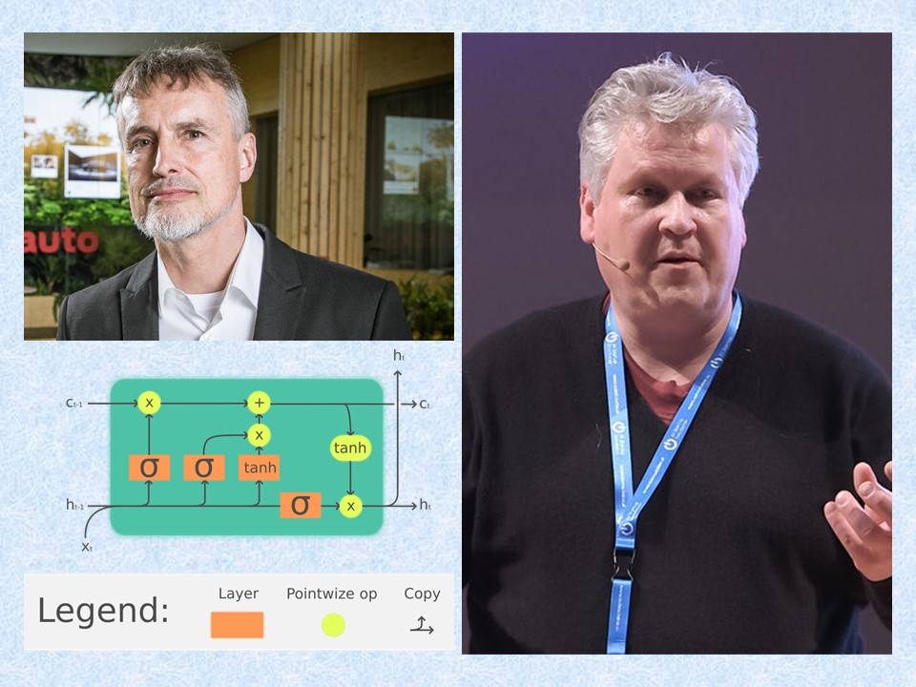
Long Short – Term Memory (LSTM)
Sepp Hochreiter and Jürgen Schmidhuber

Slide 3
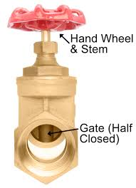
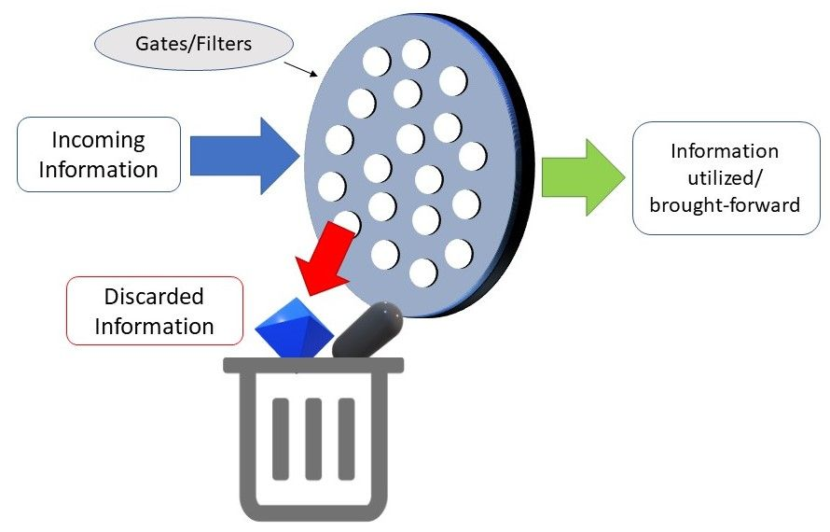
LSTM Gate
input
3
-5
3
-2
5
Gate
1
0
0.5
1
0
Output
3
0
1.5
-2
0
X

Slide 4
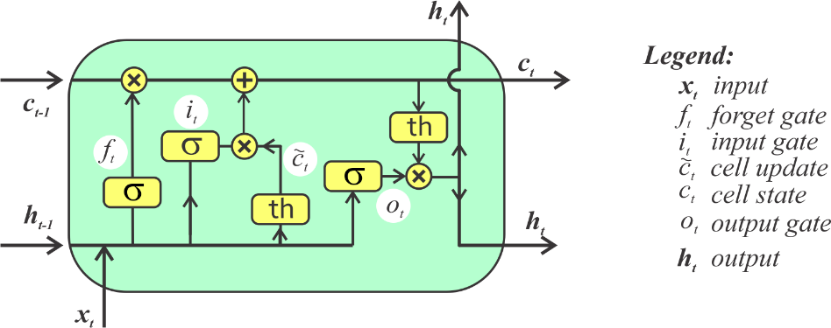
LSTM – Forget, Input, Output
forget
Input
Output

Slide 5
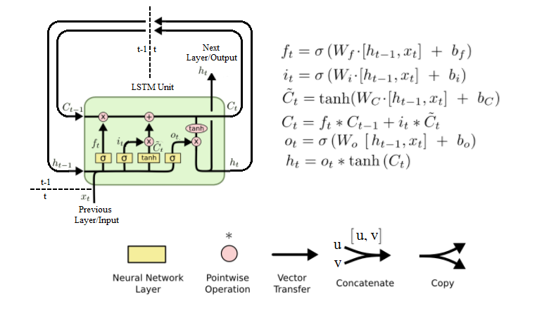
LSTM Equations

Slide 6
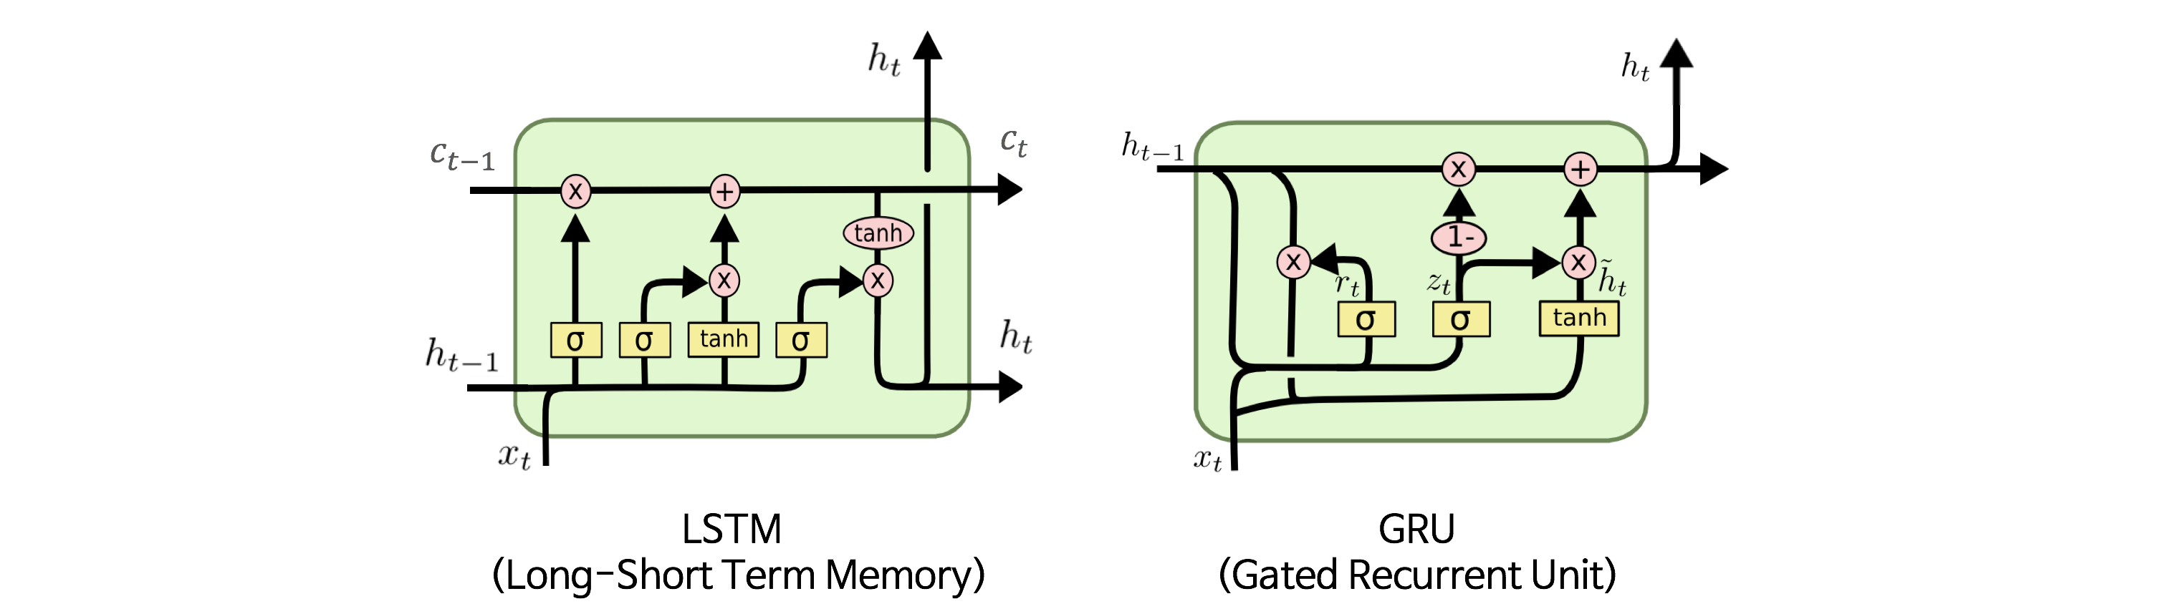
GRU & LSTM
GRU is quicker to train
GRU has less representational power

Slide 7
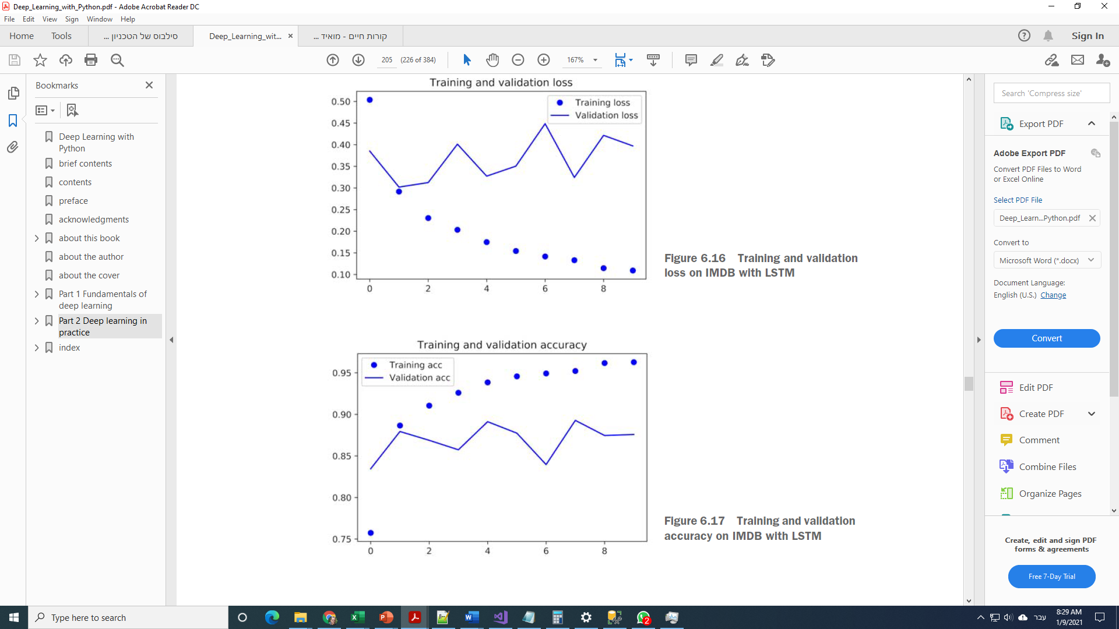
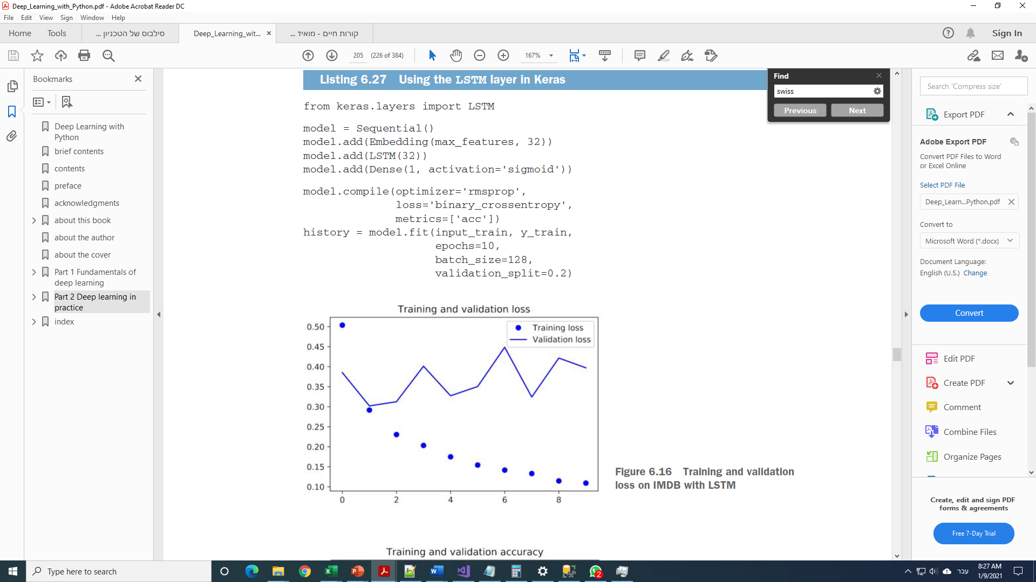
Keras Code

Slide 8
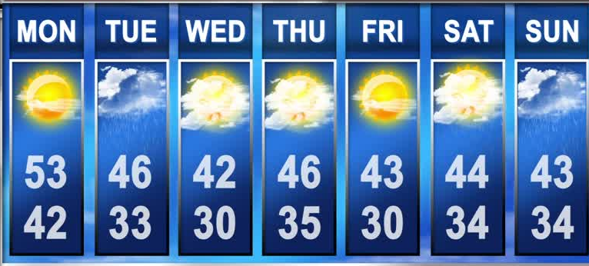
Weather Forecast Analysis Example
The challenge: Estimate the temperature in 24 hours ahead, based on data from the previous 5 days
https://github.com/fchollet/deep-learning-with-python-notebooks/blob/master/6.3-advanced-usage-of-recurrent-neural-networks.ipynb

Slide 9
Solution strategies
Having a simple benchmark to beat
Start with a simple solution (simple shallow NN)
Use GRU
Add dropouts in RNN’s
Bi-Directional RNN

Slide 10
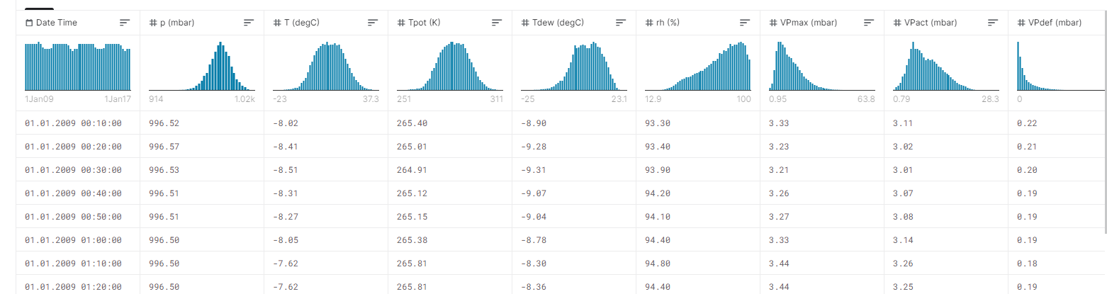
The Data
https://www.kaggle.com/stytch16/jena-climate-2009-2016
Normalize the data
Sub-sample (10min – 1 hour)

Slide 11
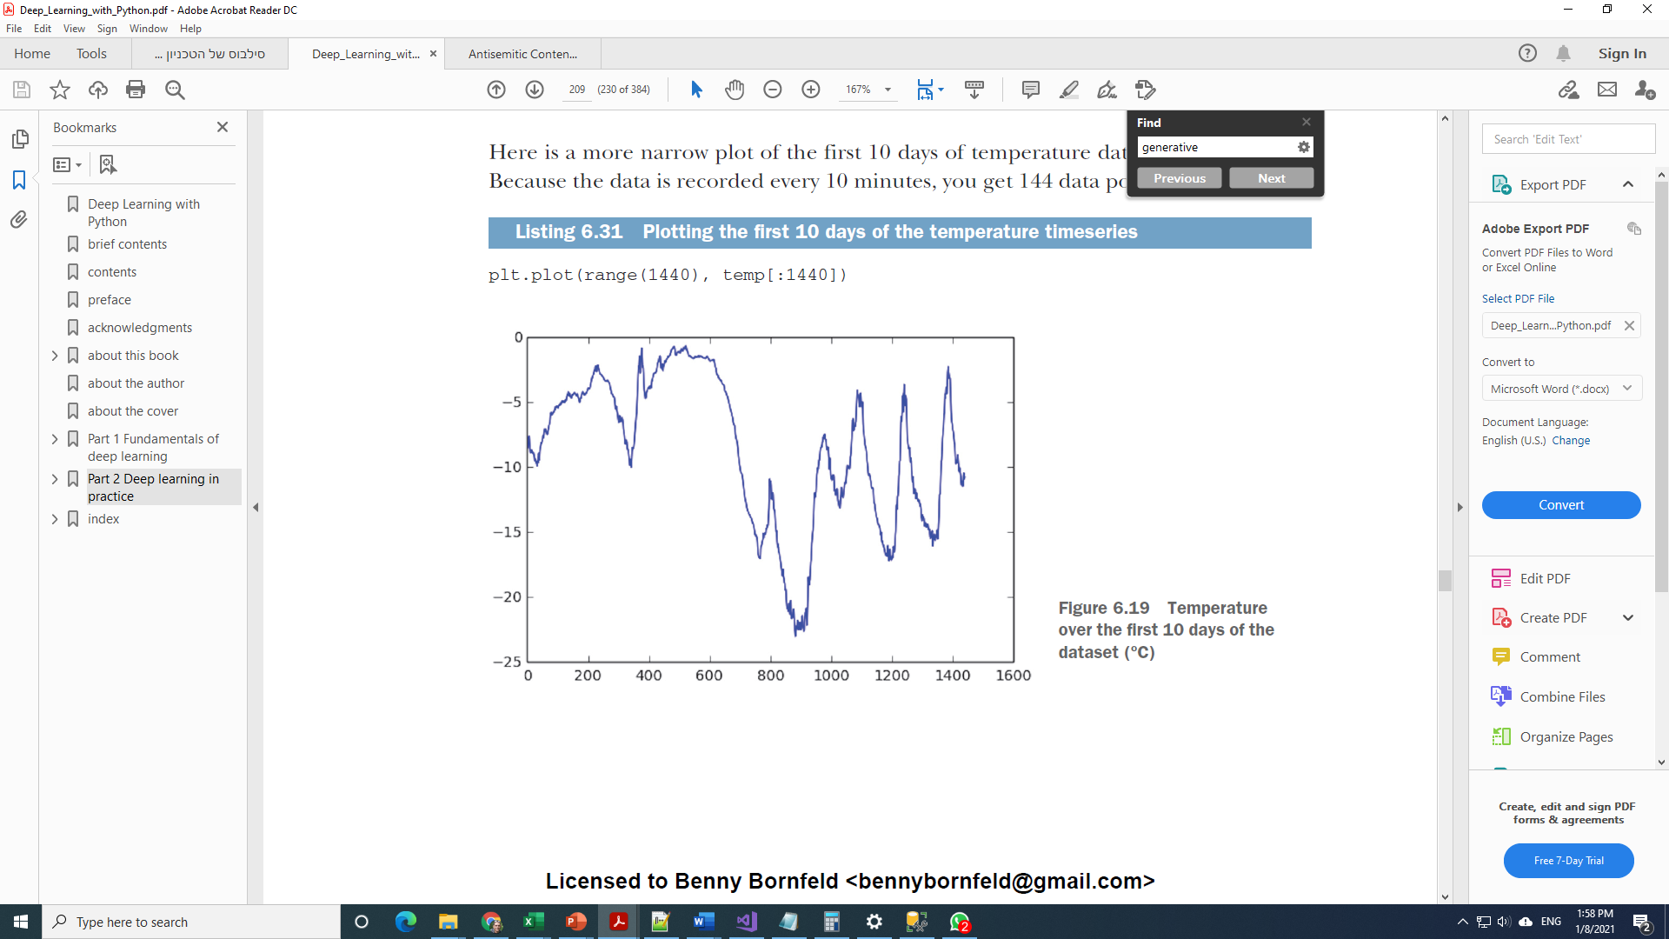
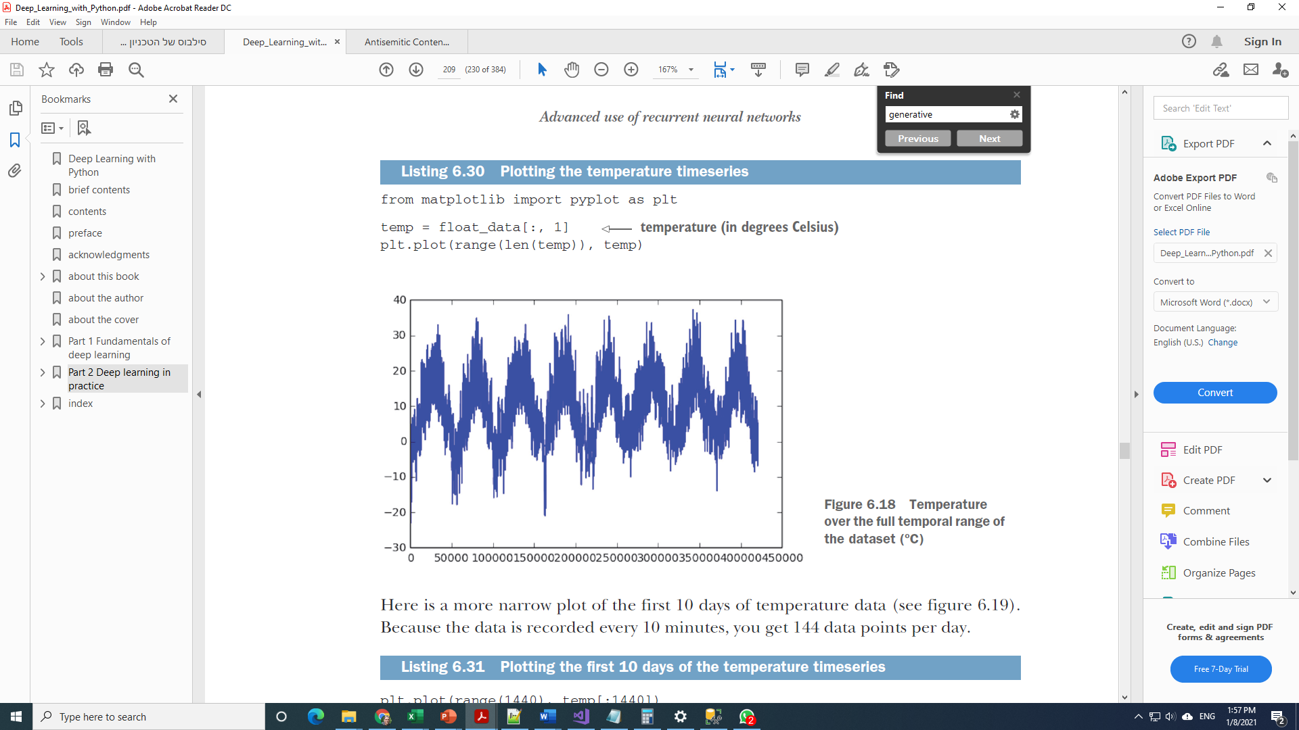
Quick View of the data
5 days
24
hours

Slide 12
Simple common-sense benchmark to beat
Assume that the temperatures will be identical to the last time record
MAE: STD 0.29 , 2.57C

Slide 13
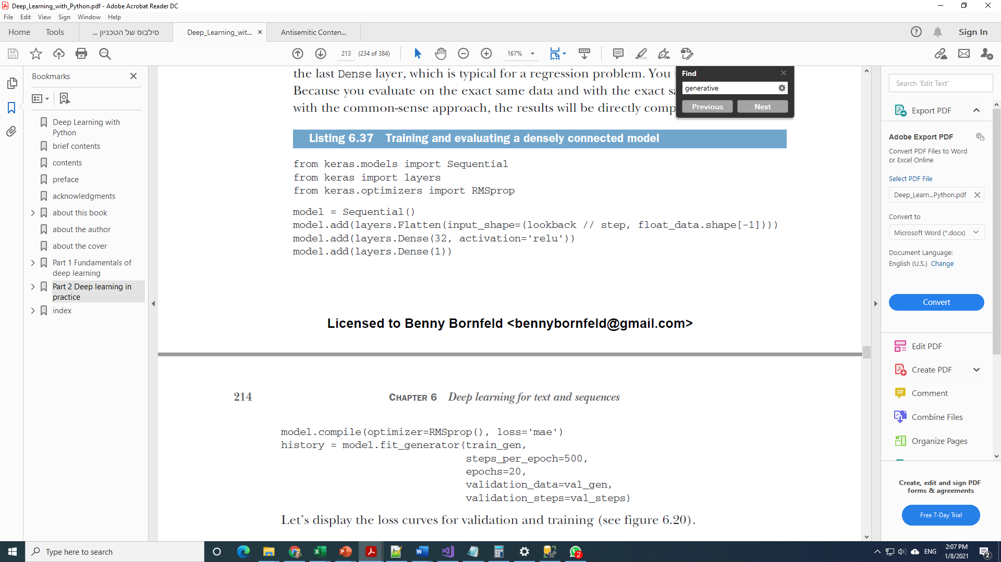
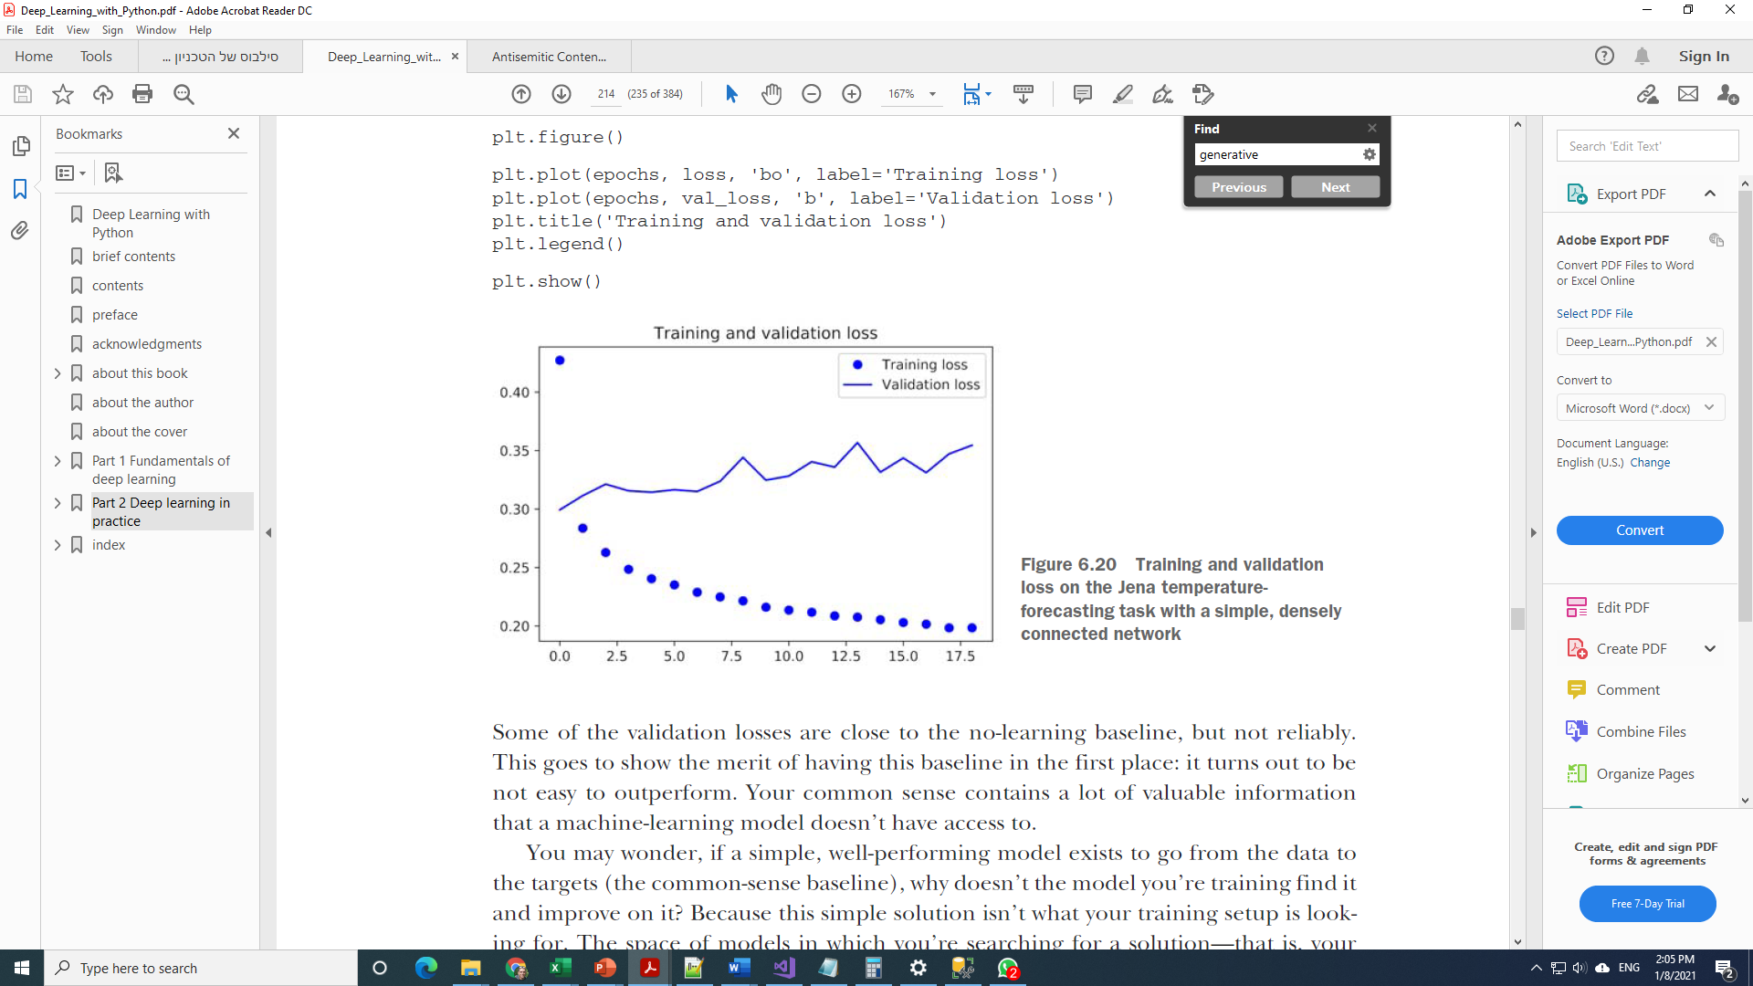

Simple two Layer NN
Flattening looses temporal order

Slide 14
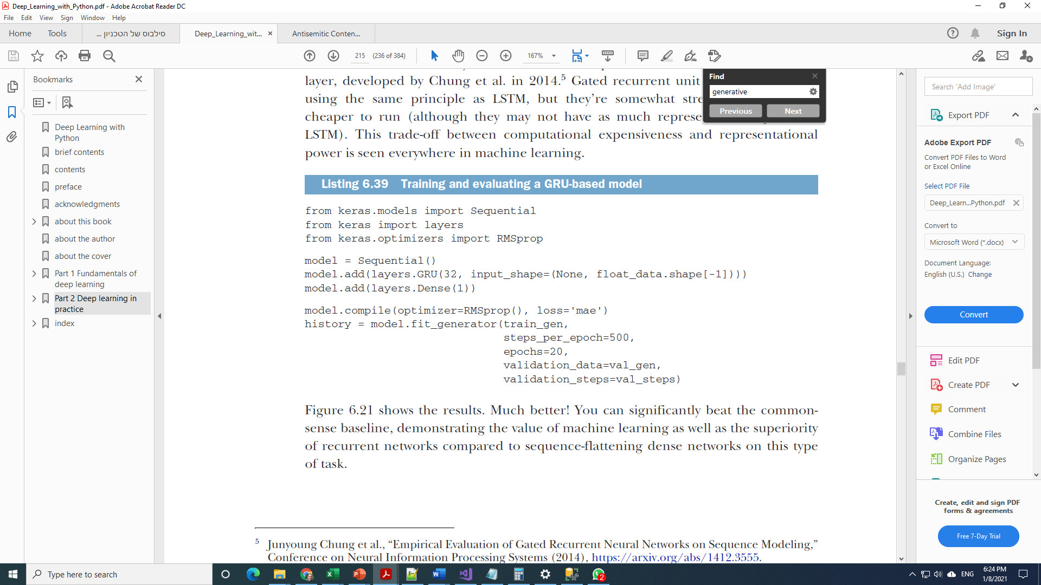
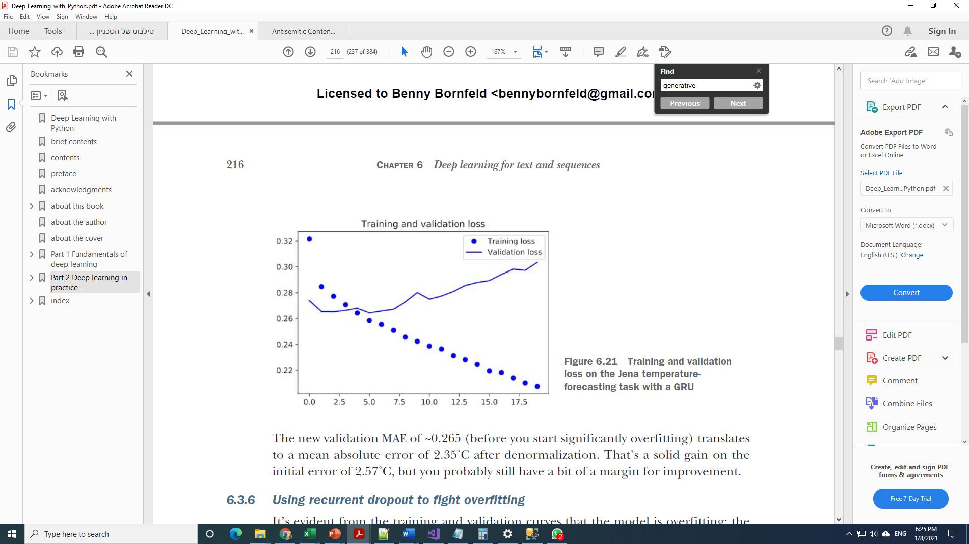

GRU

Slide 15
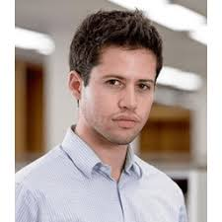
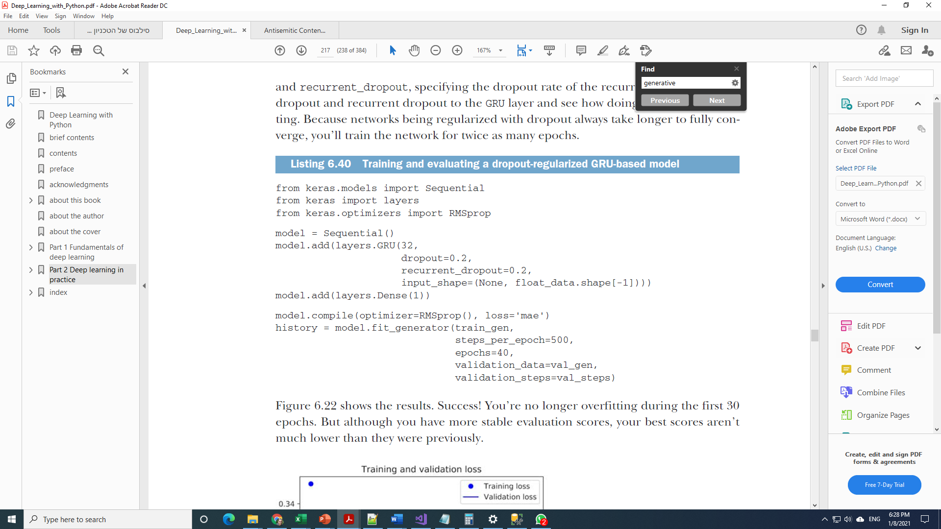
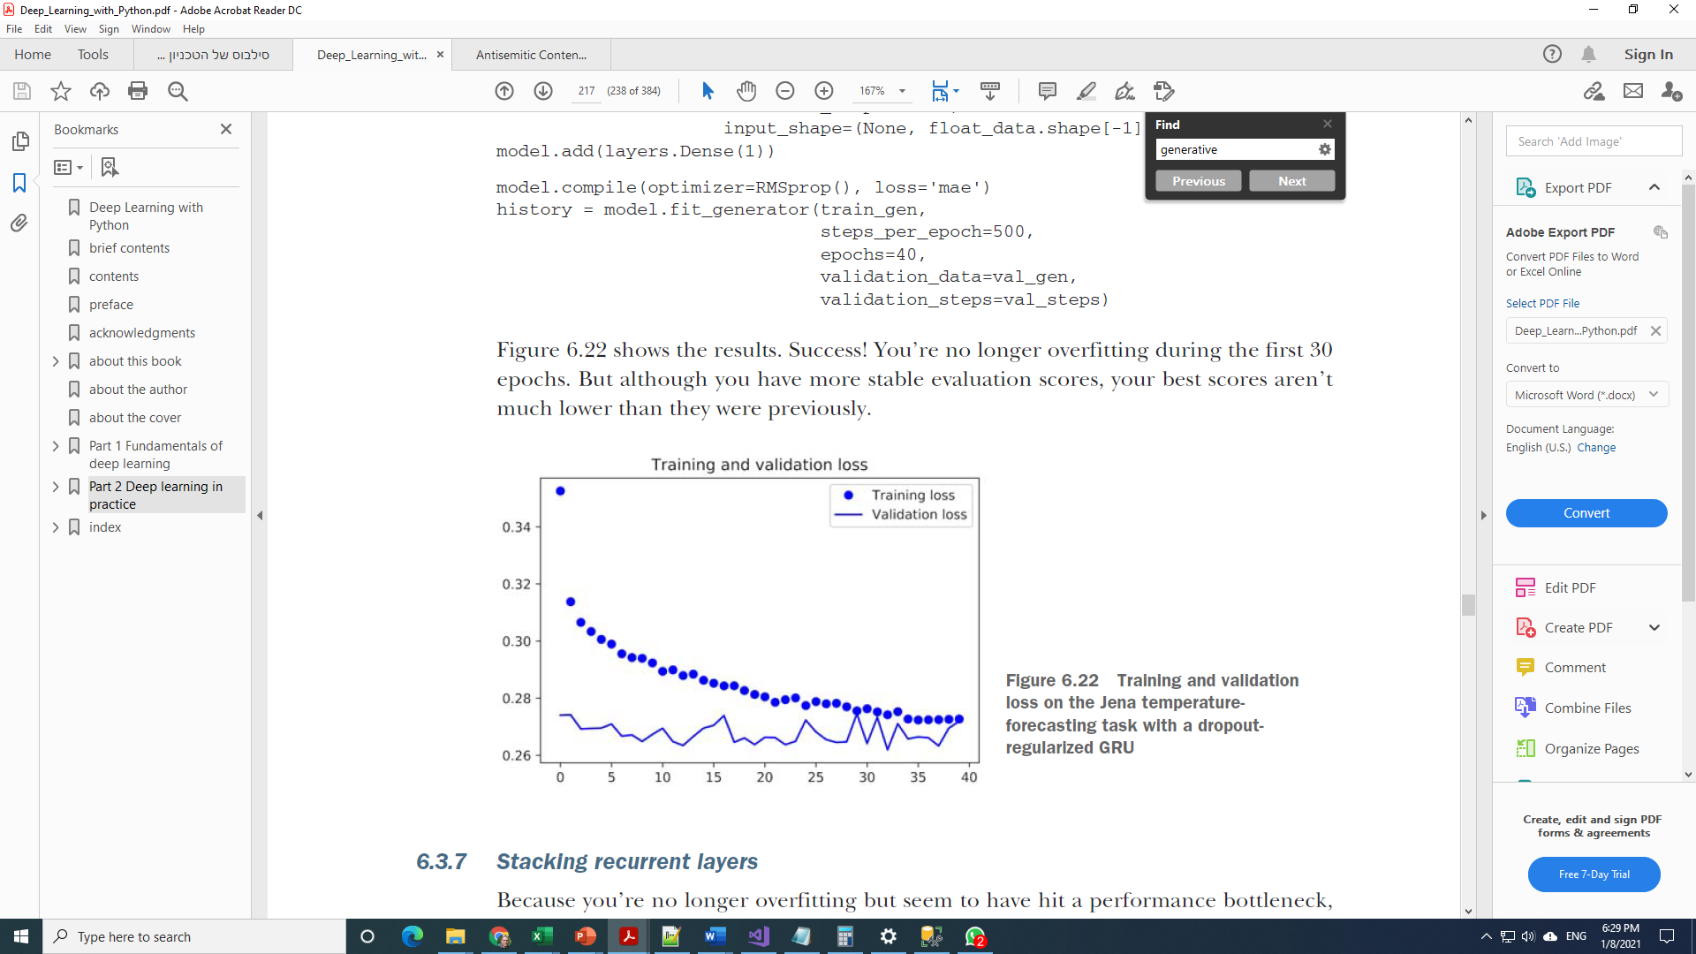
Adding RNN Dropout
Specific Dropout mechanism
Yarin Gal

Slide 16
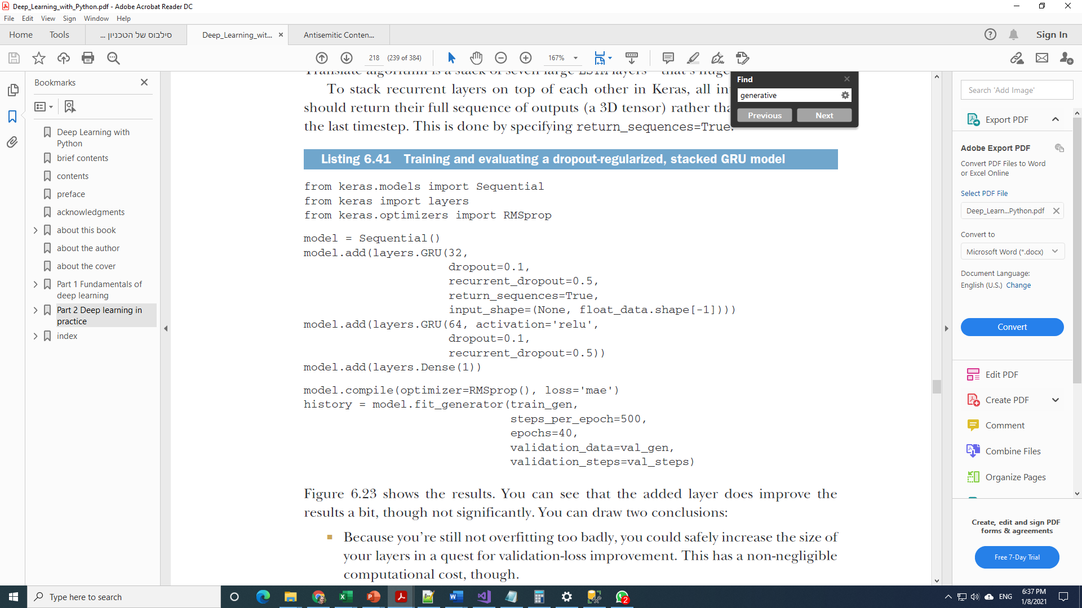
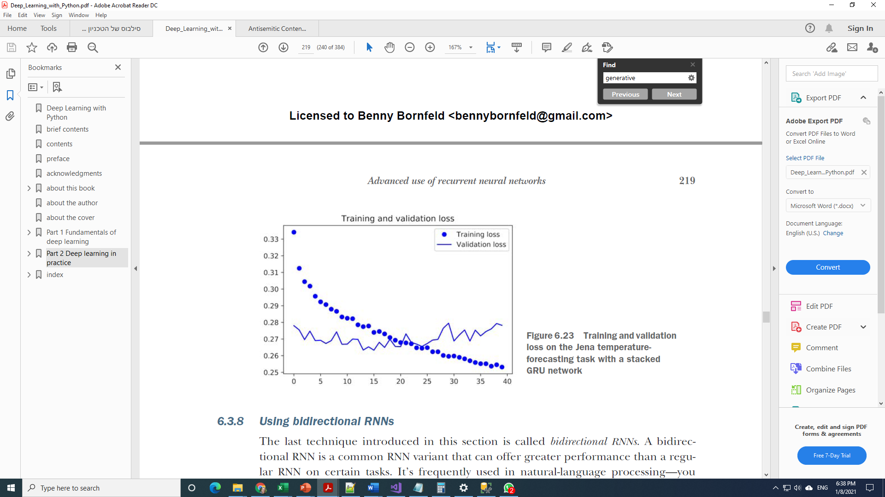
Stacking Recurrent layers
Didn’t help here… But Google Translate has 7 stacked layers!!!

Slide 17
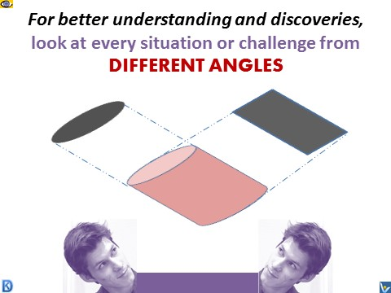
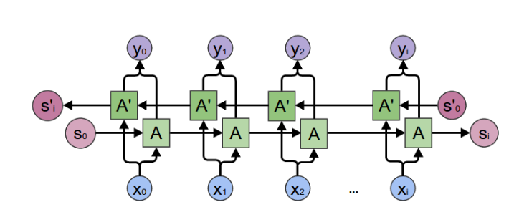
Bi-Directional RNN
5 days
24
hours
5 days
24
hours

Slide 18
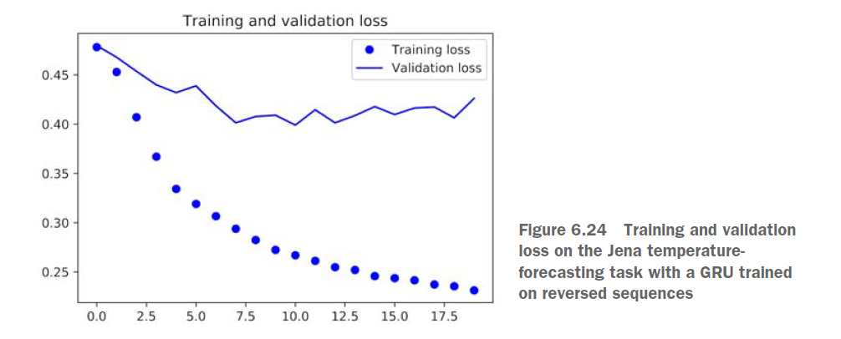
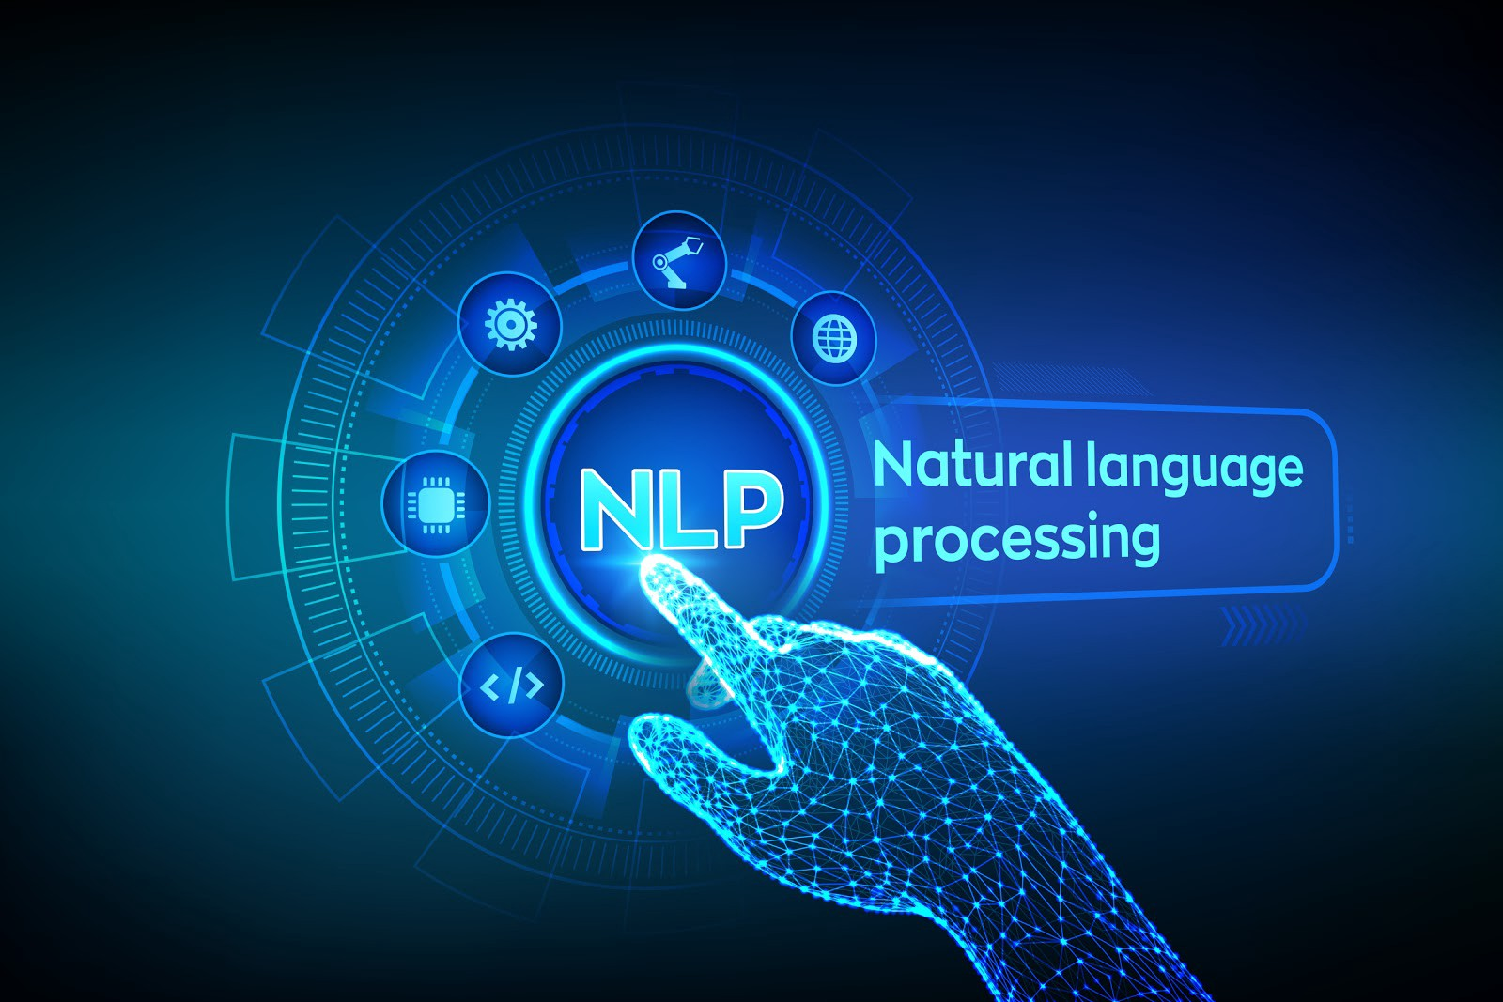
Bi Directional RNN - Results
GRU layer will typically be better at
remembering the recent past than the distant past
Recent weather data points are more predictive than older data points for the problem
Bi-Directional RNN are very useful in NLP

Slide 19

Take home message
Advanced RNN’s overcome the vanishing gradient problem and are able to have long memory
They are expensive to train
They use combinations of networks and gates (filters) in which they learn what to keep and what to forget
The main architectures are LSTM and GRU
Bi-Directional approach may provide better representation (especially in NLP)
Exploration guidelines
Have a common-sense guideline
Start simple
Try different strategies

